Slide 1
An Enhanced Automatic Song Genres Classification Using Deep Learning Technique
Under Guidance of:
Mr. A. Sudhakar
Assistant Professor
Dept. of CSE
LBRCE
Project Members:
V.Bhargav (16761A0559)
G.Krishna Reddy(16761A0516)
T.Sai Nikhil(16761A0554)
B.Komal Sai(16761A0505)

Slide 2
OUTLINE
Abstract
Existing System
Proposed work
System Architecture
Feature Extraction
CNN Model
Project Requirements
Results
Conclusions
References

Slide 3
Abstract
As humans, we can easily classify two songs by listening to them, but in the case of automating the classification, Machine Learning comes into the picture. Classical ML algorithms can make a decent classification based upon temporal (Zero Crossing Rate, signal, etc.) and spectral (centroid, roll-off, flux) features that are dependent on time domain and frequency-based features. By understanding music on a deeper scientific level, this project aims at classifying various songs into genres. We used a neural network model in this project, i.e. a CNN based on GTZAN dataset consisting of 1000 songs.

Slide 4
Existing System
Categorization Of songs are mostly based on movies and artists.
Most recommender systems are based on historical data of users.
Searching for required song takes longer time.
Continuous change of human interests is unpredictable.
Current accuracy of classification model is up to 61 percent only.

Slide 5
Proposed work
Developing a music application that categorizes songs based on songs present in the system.
Easy to Use system.
Able to access the desired song within less time.
Using feature extraction techniques and genre classification paradigms.

Slide 6
System Architecture
There are mainly three steps involved in development of desired model
Data collection and cleaning
Feature Extraction
CNN Model on Data

Slide 7
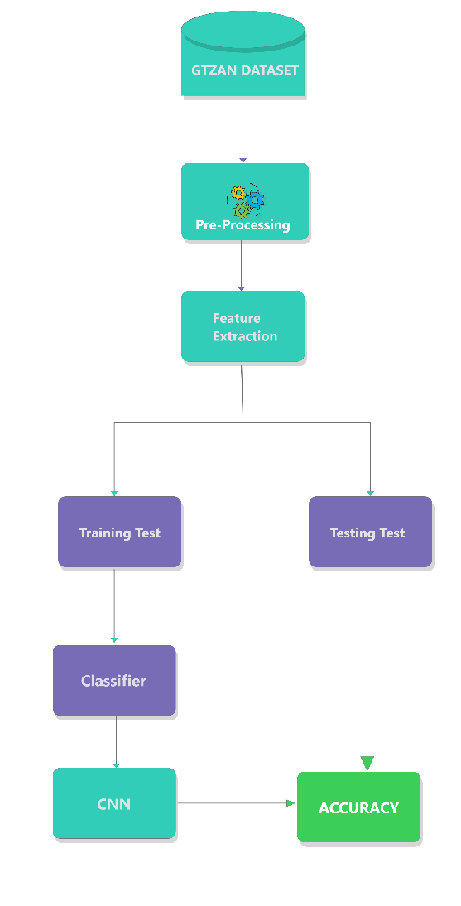
System Architecture

Slide 8
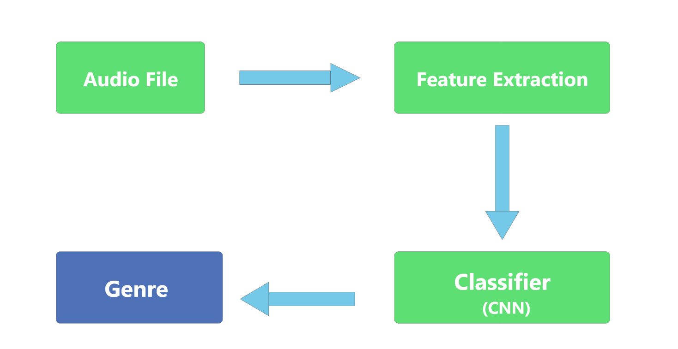
System Architecture
Over all process in a nutshell

Slide 9
Feature Extraction
Generally a song can be represented as audio signals
These signals are pictured on Mel scale (Pitch scale)
A formula is used to convert audio frequency into mels.

Slide 10
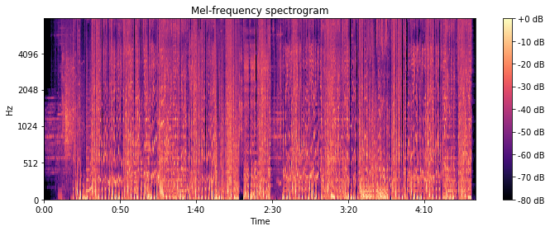
Feature Extraction
These Mel values can be represented in a graph.
This can be depicted as Mel-Spectrogram graph.
These picture can be feed as input to CNN model.

Slide 11
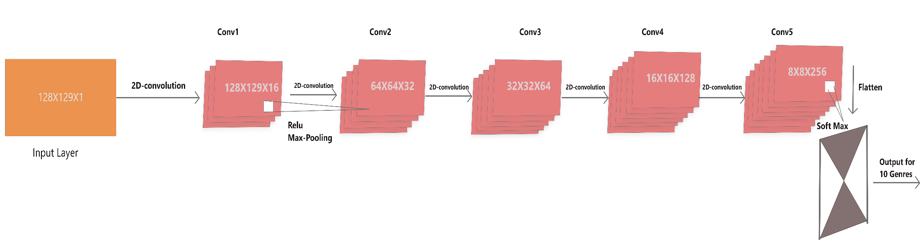
CNN Model

Slide 12
Project Requirements
Project Hardware requirements
Processer : Any Update Processer
GPU : Nvidea CUDA Enabled
Ram : Min 1 GB
Hard Disk : Min 100 GB
Project Software requirements
Programming Language : Python
GUI : Anaconda
IDE : JupyterNotebook(Gcolab)
Tool : VsCode Editor
Technology : Deep Learning
Packages : Keras,Sklearn,Flask,Numpy

Slide 13
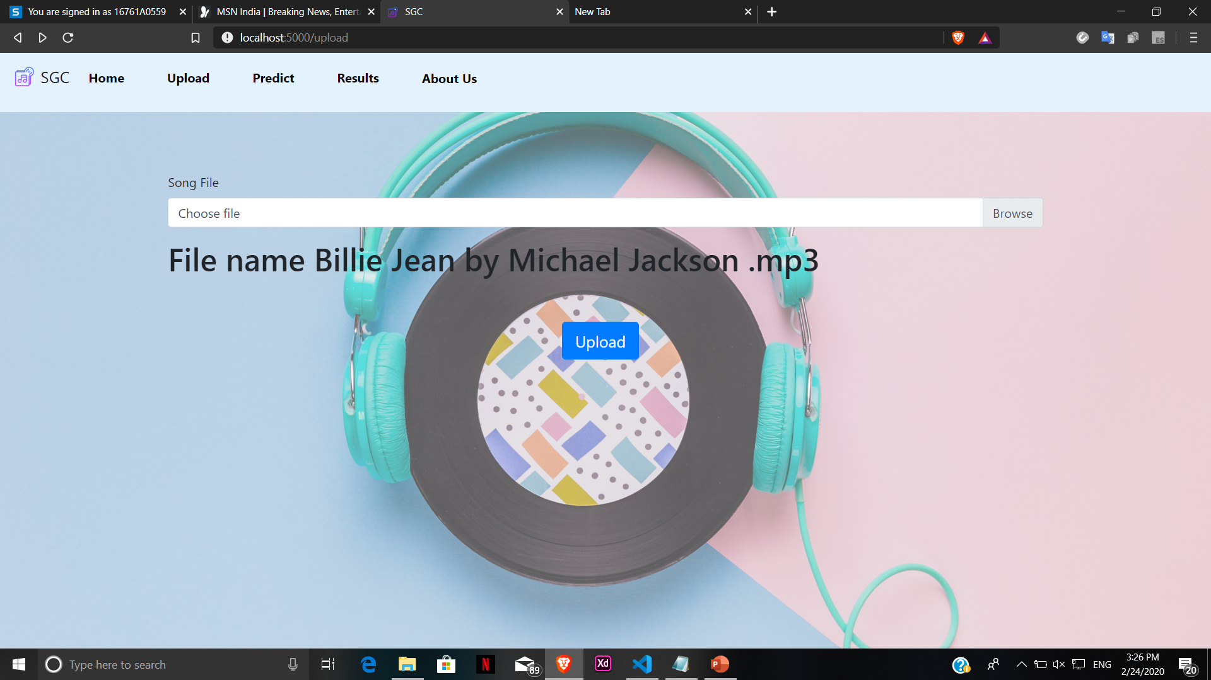
Results

Slide 14
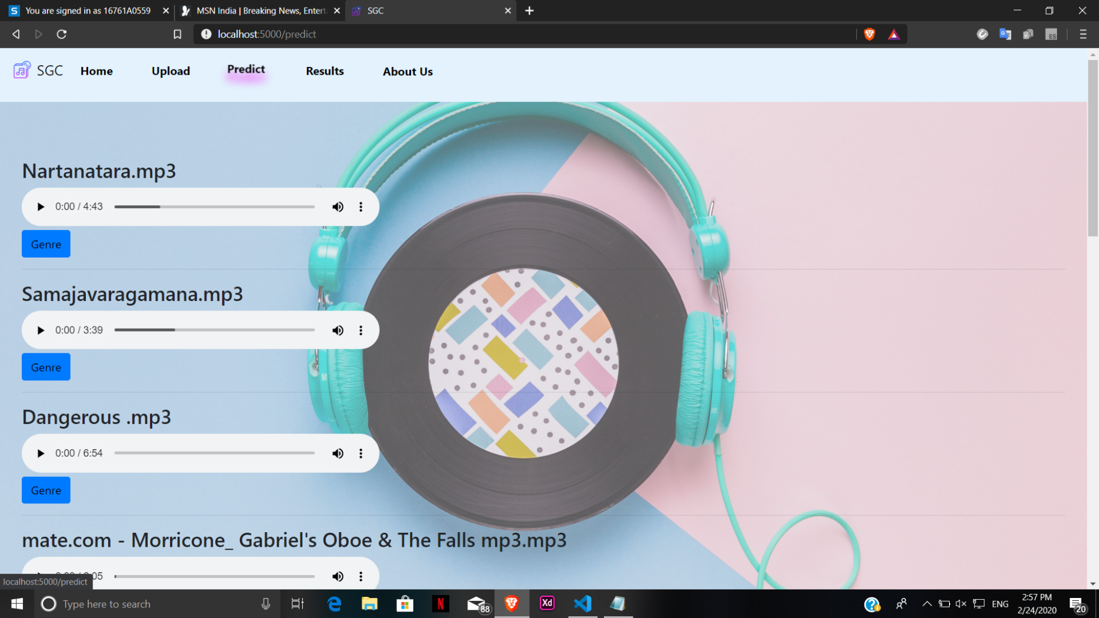
Results

Slide 15
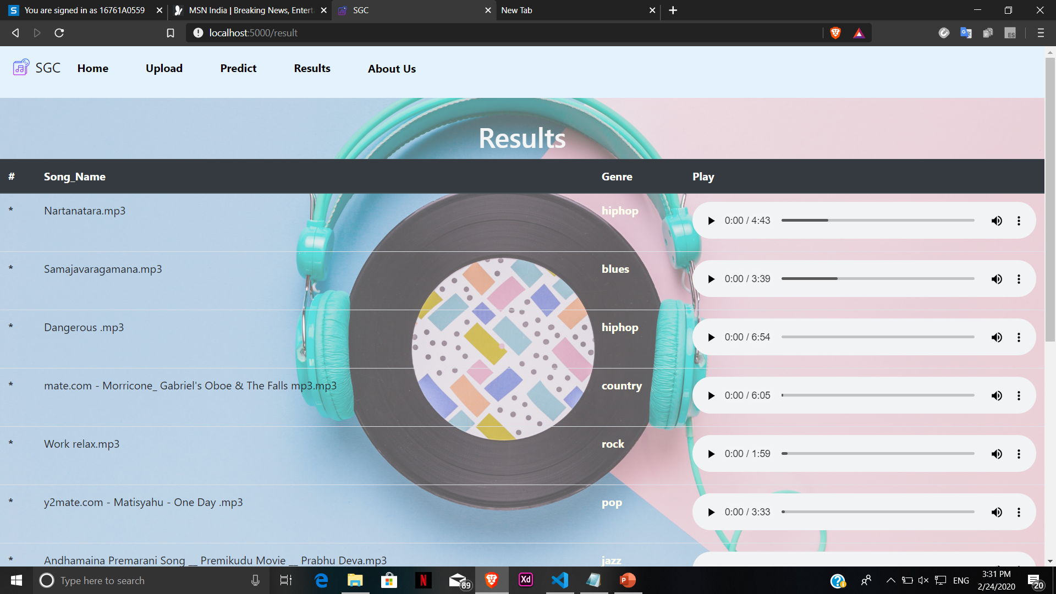
Results

Slide 16
Conclusions
At final we are able to attain 83% accuracy over our model. We will keep on training our model and try to implement parallel pipelining with RNN and CNN so that data can be processed and trained efficiently for good results. We can install this as a recommender framework for a large portion of the music platforms. Add upon features like emotion detection and playing a song according to it, which can be included as future scope.

Slide 17
References
G. Tzanetakis and Cook. 2002. Musical genre classification of audio signals. Pages [1-3]
Daniel Grzywczak and Grzegorz. 2014. Deep image features in music information retrieval. Volume 60
Jingqing Yang Music Genre Classifications with Neural Networks. An Examination of Several impactful variables. 2018. Pages[4-6]
Vedant Choudary and Aditya Vyas. Music Genre Recognition through audio samples. Pages [1-3]
https://towardsdatascience.com/getting-to-know-the-mel-spectrogram

Slide 18

Thank You
https://github.com/Lusr77/Main-Project-MGC

